Slide 1

Machine Learning-Candy Data

Slide 2
Machine Learning-Candy Data
-What are the Features ?
Chocolate, fruity, caramel, peanutyalmondy, nougat, crispedricewafer, hard, bar, pluribus sugarpercent, pricepercent
-What is the response ?
winpercent

Slide 3
EDA
w many women were survived less than 5 years and how many more than 5years? How many women were survived less and how many more than 5years?How many women were survived less than 5 years and how many more than 5years?
impacted with Age and cancer stage?

Slide 4
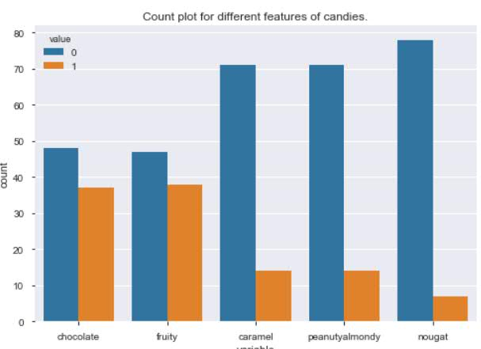
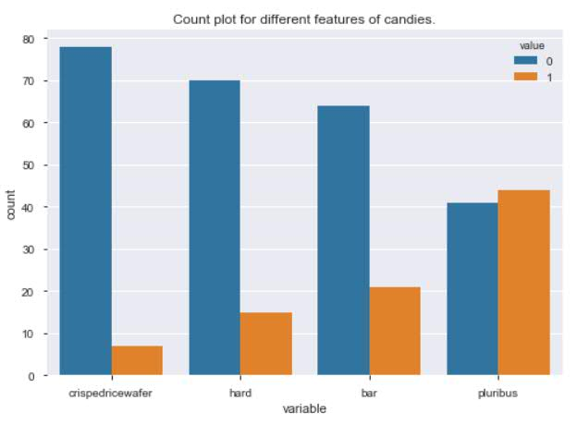
Count of different features of candies
From this graph we can see that, - Most of the cadies are pluribus, meaning they are one of the many candies in the bag or box. - Most of the candies either contains chocolate or has a fruity flavor.

Slide 5
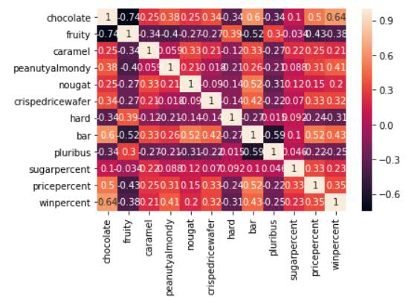
Correlation among different variables
As per the above heat map, we can see that the highest correlation with Winpercent, is for chocolate, peanutyalmondy and bar. - The highest correlation for Pricepercent is with chocolate and bar. - Chocolate has higher correlation with Bar, peanutyalmondy. - Fruity has the negative correlation with winpercent.

Slide 6
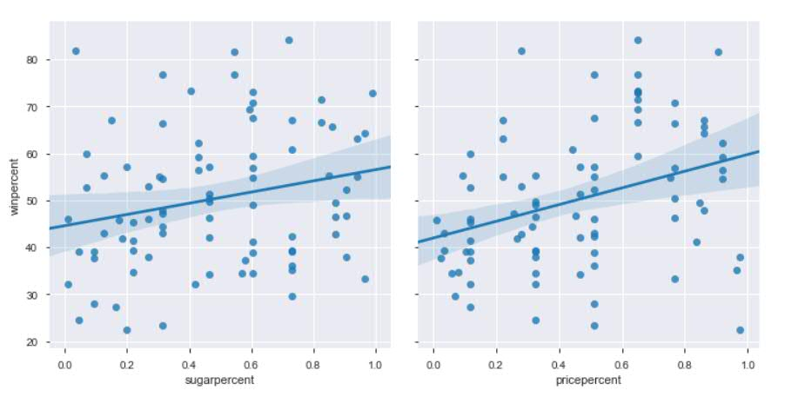
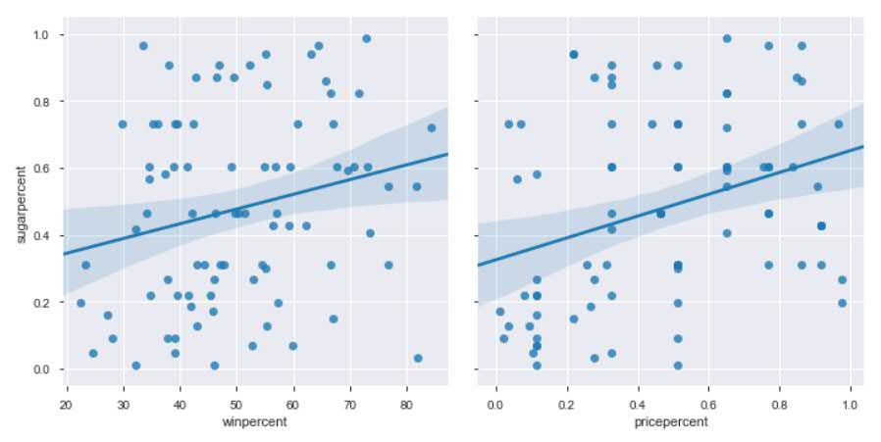
Relationship among winpercent, pricepercent and sugarpercent
As per the above plots there is no strong linear relationship among winpercent, pricepercent and sugarpercent.

Slide 7
Linear Regression Model
w many women were survived less than 5 years and how many more than 5years? How many women were survived less and how many more than 5years?How many women were survived less than 5 years and how many more than 5years?
impacted with Age and cancer stage?

Slide 8
Linear Equation with 80:20 (Train and Test) data
y = 37.94 + 17.95 * chocolate + 10.28 * fruity + 0.65 * caramel + 10.1 * peanutyalmondy + 13.18 * nougat + 14.27 * crispedricewafer - 7.41 * hard - 5.19 * bar - 2.39 * pluribus
Model Evaluation:
1. MAE for training set is 8.094423876260324 MAE for test set is 9.824327456113235
2. MSE for training set is 102.9733219515013
MSE for test set is 141.70627963075162
3. RMSE for training set is 10.147577146861279
RMSE for test set is 11.904044675266958
4. Rsquared - 0.5268
5. VIF - 2.11
Observations for (80:20)training and testing data
We could see that the candies which contains chocolate is 17.95 percentage points higher in terms of winpercent compared to candies with no chocolate.
We also observed that fruity taste has a relatively high positive coefficient which contradicts our correlation heatmap results wherein it is inversely proportional with winning percentage. This might be caused by multicollinearity since we also found out from the correlation heatmap that chocolate and fruity has a strong negative correlation.
We got the RMSE for test data 11.9 and RSquared value is 0.5268, so we can say that 52.68% of the variance of winpercent can be explained by the factors we have used.
Also we got VIF 2.11 we can say that there is no multicolinearity present in the model.

Slide 9
Linear Equation with 70:30 (Train and Test) data
y = 40.74 + 13.41 * chocolate + 4.28 * fruity -5.59 * caramel + 10.2 * peanutyalmondy + 10.40 * nougat + 18.10 * crispedricewafer -1.751 * hard -5.63 * bar -3.10 * pluribus
Model Evaluation:
1. MAE for training set is 8.094423876260324 MAE for test set is 9.824327456113235
2. MSE for training set is 103.03929233016932
MSE for test set is 175.5784027193182
3. RMSE for training set is 10.150827174677408
RMSE for test set is 13.250600089026843
4. Rsquared - 0.5078
5. VIF - 2.03
Observations for (70:30)training and testing data
- We could see that the candies which contains chocolate is 13.41 percentage.
- It is interesting to see that fruity still has a positive coefficient. Crispedricewafer has higher coefficient. One more interesting finding we can observe is that the attribute caramel from a positive coefficient in the first regression model has a negative coefficient which contradicts the results of our correlation heatmap.
- We got the RMSE for test data 13.25 and RSquared value is 0.5078, so we can say that 50.78% of the variance of winpercent can be explained by the factors we have used.
- Also we got VIF 2.03 we can say that there is no multicolinearity present in the model.

Slide 10
Conclusions
As per our evaluation with (80:20) training and testing data chocholate is the most important attribute of a candy followed by crispedricewafer, peanutyalmondy and nougat.

Slide 11
Thank You !!

